Slide 1
MedTech Cloud
Security Assessment
AWS Security & Compliance Review
Adarsh Rai, Anupam Rajeev, Chandan Vedvyas, Kush Patel

Slide 2
Executive Summary
IVS 20%
IAM 35%
Security maturity is developing but not yet compliant with HIPAA or CCM standards.
Critical risks identified in identity management, PHI data protection, and logging.
Foundational controls exist, but lack of encryption, monitoring, and access governance creates systemic exposure.
LOG20%
DSP30%
Compliance Status - Partial alignment
CSA CCM v4.0: 60% implementation maturity.
HIPAA §164.312: Gaps in audit, encryption, and access safeguards.
AWS Well-Architected Framework: Missing automation and detection controls.
Notes:
Based on our analysis across four domains—Identity & Access Management, Data Security & Privacy, Infrastructure Security, and Logging & Monitoring—the environment demonstrates developing maturity, but significant compliance gaps remain.
As shown in the pie chart, most of the organization’s risk is concentrated in identity management and data protection, both of which are directly tied to HIPAA’s technical safeguards for encryption, access, and integrity.
The team identified several critical issues: – IAM users without multi-factor authentication or password policies, – Patient health information stored unencrypted in S3, – Network exposure of database resources, and – Absence of centralized logging or threat detection tools.
While foundational AWS controls are in place—such as account-level public access blocks and service separation—the current state would not meet HIPAA or CSA CCM compliance expectations without significant remediation.

Slide 3
Assessment Methodology
CCM + HIPAA + AWS WAF
IAM
DSP
LOG
IVS
Assessment Approach
AWS CLI evidence collection
Console configuration review
HIPAA compliance mapping
~20 CCM control evaluated
Identity and Access Management
Data Security & Privacy
Logging & Monitoring
Infrastructure & Virtualization Security
Notes:
We conducted this security evaluation using the Cloud Security Alliance's Cloud Controls Matrix—or CCM—which is the industry standard framework for assessing cloud security posture. This isn't just a checklist exercise; the CCM is recognized globally and aligns directly with HIPAA requirements, making it the perfect tool for our healthcare environment.
"We focused on four critical security domains: First…. Identity and Access Management—user authentication and permissions. Second….Data Security and Privacy—protecting patient health information. Third…. Logging and Monitoring—detecting and responding to security incidents. Lastly…… Infrastructure & Virtualization Security—our network architecture and defenses."
Our methodology was thorough and evidence-based. We used AWS CLI commands to collect configuration data, performed hands-on console reviews, and mapped every finding back to specific HIPAA requirements. In total, we evaluated roughly 20 individual CCM controls across these four domains.

Slide 4
IAM Findings
Control ID | Finding | Risk Level | HIPAA Impact
IAM-01: User Access Management | MFA disabled for all IAM users (AccountMFAEnabled = 0). | Critical | Violates §164.312(a)(2)(i) – Unique User Identification and §164.312(d) – Authentication of Users.
IAM-01 / Root Account Protection | Root account console enabled without MFA. | Critical | Total account compromise risk; full administrative control exposure.
IAM-03: Authentication Strength (Password Policy) | No account-level password policy configured (NoSuchEntity error). | High | Weak passwords undermine user identity integrity and audit traceability.
IAM-05: Access Key Management | Long-lived access keys active for medtech-assessment-student; one unused. | High | Shared or unrotated credentials risk unauthorized PHI access.
Notes:
“Our IAM assessment identified four major control gaps under the CSA Cloud Controls Matrix.
First, MFA is disabled for all IAM users, including the root account, which directly violates HIPAA §164.312(a)(2)(i) for unique user identification.
Second, the root account remains unprotected by MFA — the single most critical vulnerability in this environment.
Third, no password policy exists, allowing weak or shared credentials.
And finally, long-lived and unused access keys were found for several users, increasing the risk of credential compromise.
Collectively, these IAM issues create a high likelihood of unauthorized access to ePHI and expose MedTech to regulatory and financial penalties.”

Slide 5
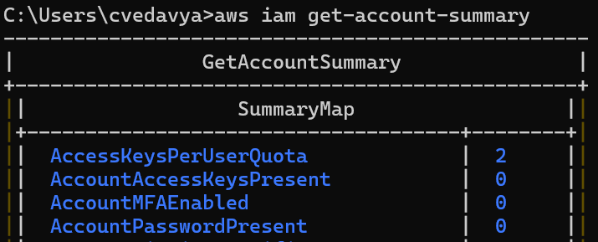
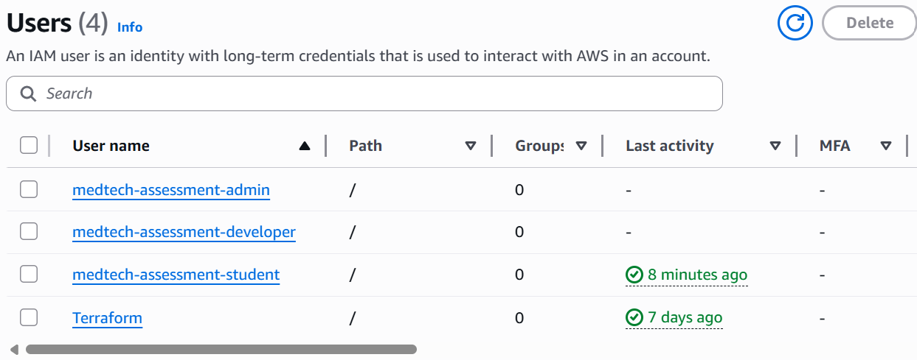
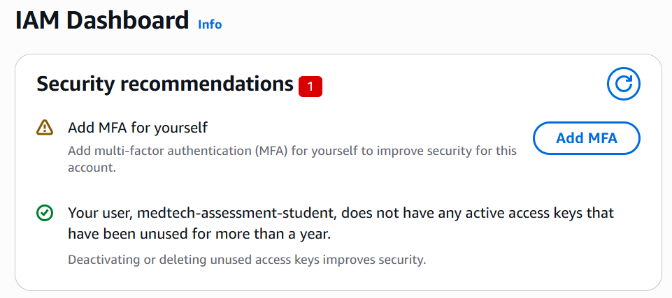
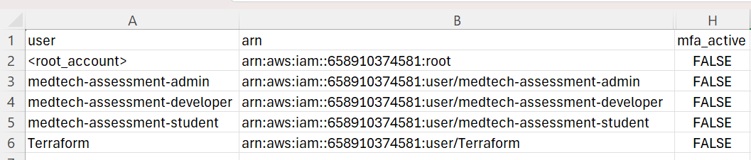
IAM Finding Evidences
Notes:
“This slide shows how each finding was verified through both AWS CLI and console evidence.
The get-account-summary command confirms MFA and password policies are disabled.
The IAM user list shows all four users without MFA enabled.
The credential report verifies the same with ‘mfa_active = FALSE’ for every user.
Finally, the IAM dashboard itself flags the missing MFA as a high-priority security recommendation.
These evidences together provide strong validation of the IAM control weaknesses and form the technical proof for our findings.”

Slide 6
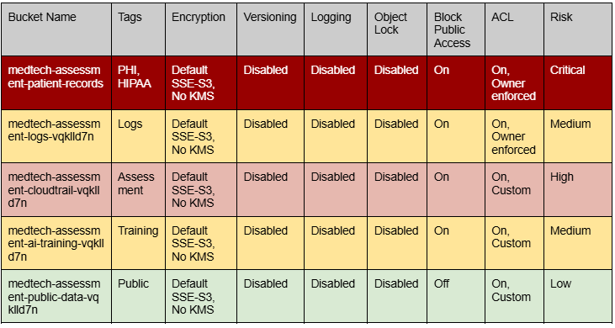
S3 Buckets DSP Findings
Critical – Patient Records (PHI)
Sensitive information is stored without KMS encryption, versioning, or access logging. Violates HIPAA’s requirements for encryption and integrity, creating the highest compliance and breach risk.
High – CloudTrail Audit Logs
Audit logs lack immutability, versioning, and defined retention. In a security incident, this would prevent reliable forensic investigation
Medium – AI Training and System Logs
AI and log buckets are unencrypted, unclassified, and lack lifecycle management.
Notes:
This slide summarizes our key findings and remediation plan for the Data Security and Privacy domain.
The Patient Records bucket presents the most critical issue: PHI data stored with only SSE-S3 encryption, no versioning, and no audit trail. This violates HIPAA encryption and integrity safeguards.
The CloudTrail audit bucket, rated high, lacks immutability controls. Without versioning or Object Lock, audit evidence could be deleted or altered.
Finally, the AI Training bucket, while not containing direct PHI, poses moderate risk due to unsecured datasets and potential model data leakage.
Our remediation strategy focuses on three phases: Immediate encryption and logging fixes, short-term lifecycle and immutability enhancements, and long-term automation through AWS Config and tagging.
Once these measures are in place, MedTech’s data protection posture will meet both HIPAA and CSA CCM standards for encryption, integrity, and audit control.

Slide 7
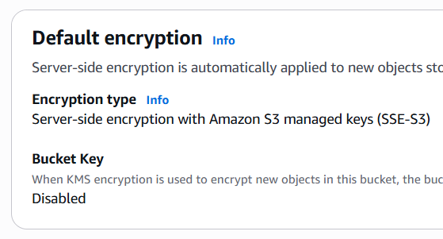
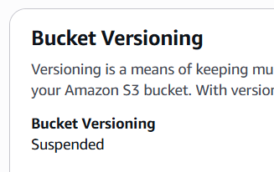
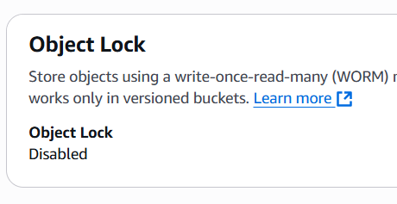
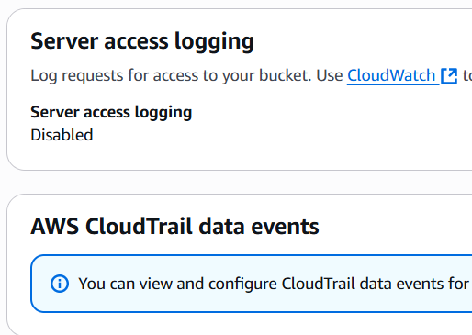
DSP - Compliance & AWS Remediations
Patient Records – Critical
SSE-S3 only; versioning, logging, Object Lock disabled.
Enable SSE-KMS, Versioning, Object Lock, 6-yr retention. HIPAA: §164.312(a)(2)(iv)(1) CCM: DSP-03, DSP-06, DSP-08
CloudTrail Logs – High
No immutability or lifecycle; SSE-S3 only.
Add Object Lock, KMS, retention ≥ 6 yrs; restrict write access.• HIPAA: §164.312(b) CCM: LOG-01, DSP-06
AI Training Data – Medium
Unclassified, unencrypted (SSE-S3); no versioning/logging.
Apply SSE-KMS, Versioning, Classification Tags, VPC isolation. HIPAA: §164.312(a)(2)(iv),CCM: DSP-02, DSP-03 • OWASP LLM: A1, A2
Notes:
This slide links our key findings directly to evidence gathered from the AWS Console and CLI, along with specific remediations required to close each gap.
For the Patient Records bucket, screenshots show that encryption relies only on default SSE-S3 with no KMS key, versioning is suspended, and logging is disabled. These settings leave PHI data mutable and non-auditable. The fix involves enabling KMS encryption, versioning, and Object Lock to meet HIPAA’s integrity and audit standards.
The CloudTrail Logs bucket displayed similar issues—no versioning, no immutability, and default SSE-S3 encryption. Since CloudTrail logs serve as forensic evidence, the remediation emphasizes KMS encryption, Object Lock, and strict write permissions for log services only.
Lastly, the AI Training bucket contained unclassified model and dataset files, with no encryption or logging. In addition to HIPAA, this introduces risks recognized in the OWASP LLM Top 10, such as prompt-injection and data-leakage vulnerabilities. The remediation adds KMS encryption, tagging, versioning, and network isolation.

Slide 8
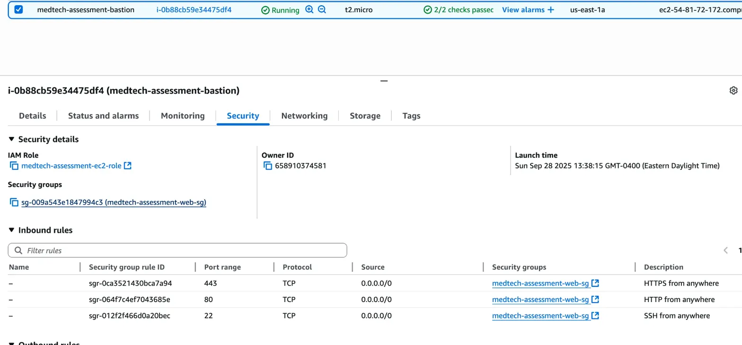
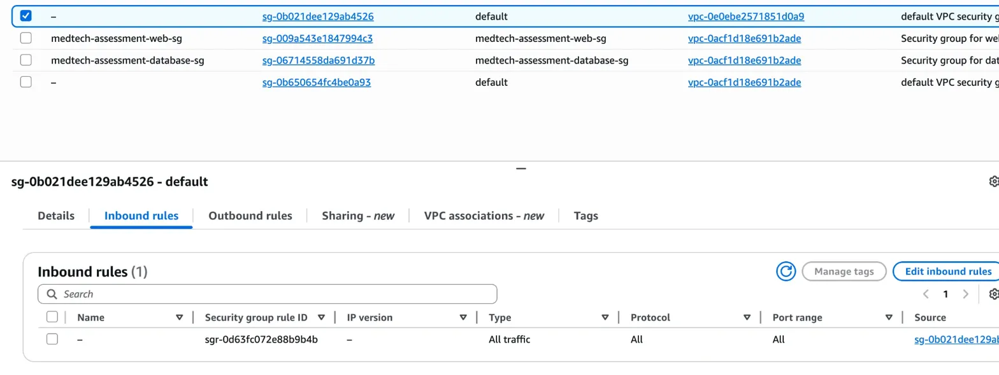
IVS
Infrastructure & Virtualization Security
SSH bastion host
CCM: IVS-03 (Network Security)
CRITICAL
Business Impact:
Hackers can break into web servers
Access to all private resources
Patient data breach, ransomware, or system compromise
Unavailability (Brute force from SSH)
Penetration tests flag - immediately
Major compliance violation for SOC 2, PCI-DSS, HITRUST
HIGH
Default VPC
CCM: IVS-08
(Network Architecture Documentation)
Notes:
Infrastructure & Virtualization Security - we have a major vulnerability that requires immediate action.
What you're seeing on the screen is our SSH bastion host—the gateway into our entire infrastructure. Look at those inbound rules highlighted in red. Port 443, port 80, and port 22—all open to 0.0.0.0/0. That means the entire internet.
Now, why is this such a big deal? First, hackers can break into our web servers through these open ports. Once they're in the bastion host, they have access to ALL of our application servers, our databases, everything. This violates CCM control IVS-03, which requires proper network security and segmentation. This could trigger ransomware attacks, complete system compromise, or massive data exfiltration.
This is a major violation for SOC 2, PCI-DSS if we handle any payment data, and HITRUST certification.
Looking at the bottom screenshot our default VPC security group—you can see it's configured to allow ALL traffic from ALL sources. This is the AWS default, and we never locked it down.
The good news? This is fixable within hours. We need to immediately restrict SSH access to only our office IP ranges or VPN endpoints with MFA.

Slide 9
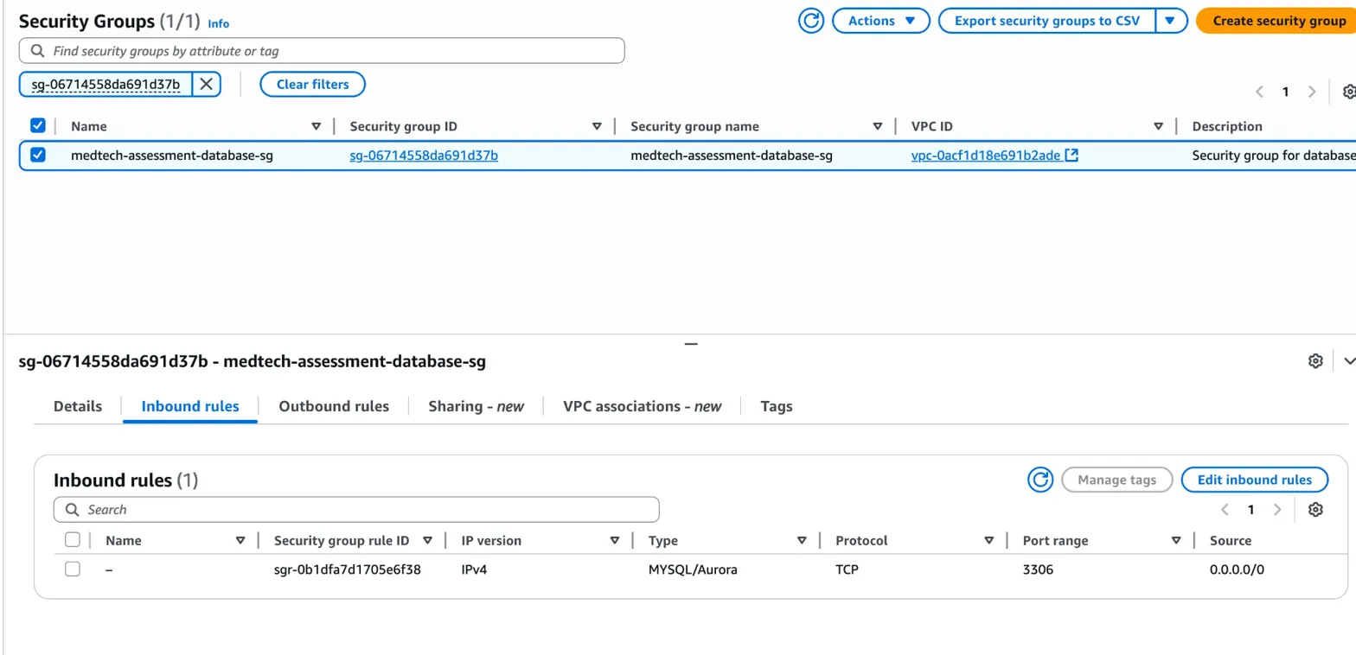
IVS
Infrastructure & Virtualization Security
Database
Exposed to Internet
CCM: IVS-03 (Network Security) & DSP-04 (Data Protection)
Business Impact:
- HIPAA violation ePHI accessible from public internet
- Direct path to patient medical records if credentials compromised
- Database can be targeted for:
* SQL injection attacks
* Brute force password attacks
* Ransomware encryption
* Data exfiltration
CRITICAL
Notes:
If the previous finding was critical, this one is catastrophic. Our patient database—port 3306—is open to the entire internet. Anyone, anywhere can attempt to connect right now.
All our ePHI—patient names, diagnoses, social security numbers—sits behind just a database password. No network segmentation, no VPN, no MFA. We're facing SQL injection, brute-force attacks, and hundreds of thousands of login attempts daily.
This violates IVS-03 and DSP-04, and it's a severe HIPAA violation. We're looking at $100K to $1.5M in fines, plus the average healthcare breach cost of $10.93 million.
The fix is immediate: disable 'Publicly accessible' on RDS right now, restrict the security group to our web tier only, rotate credentials, and enable encryption. This must happen today.

Slide 10
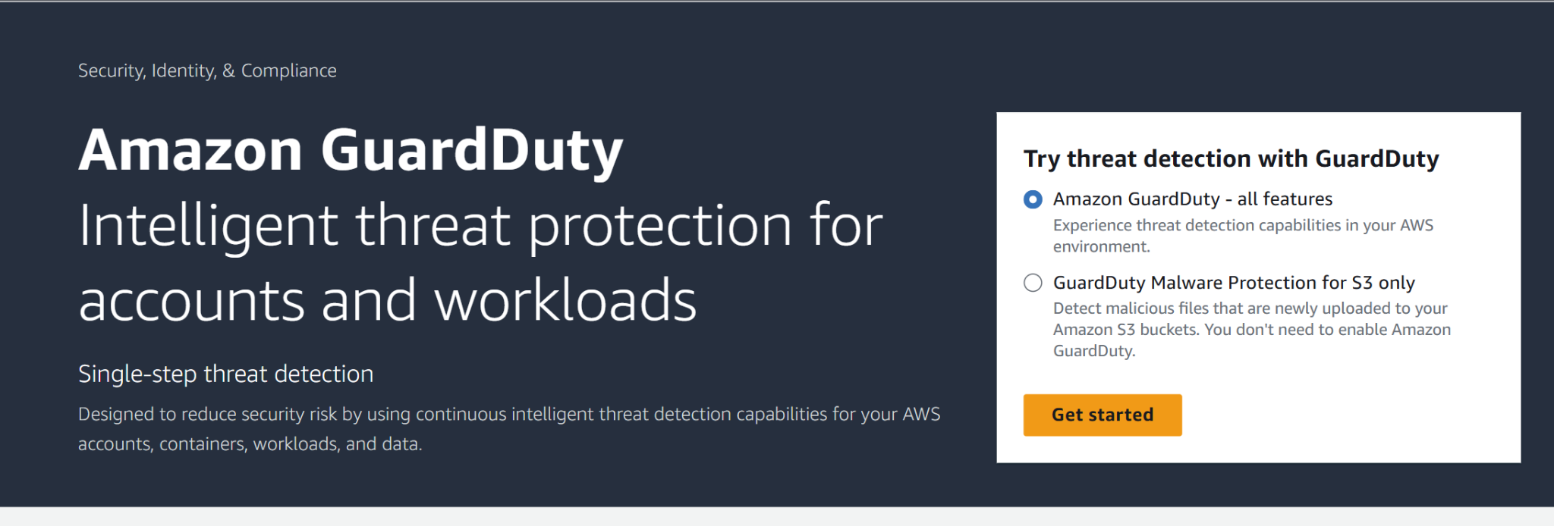
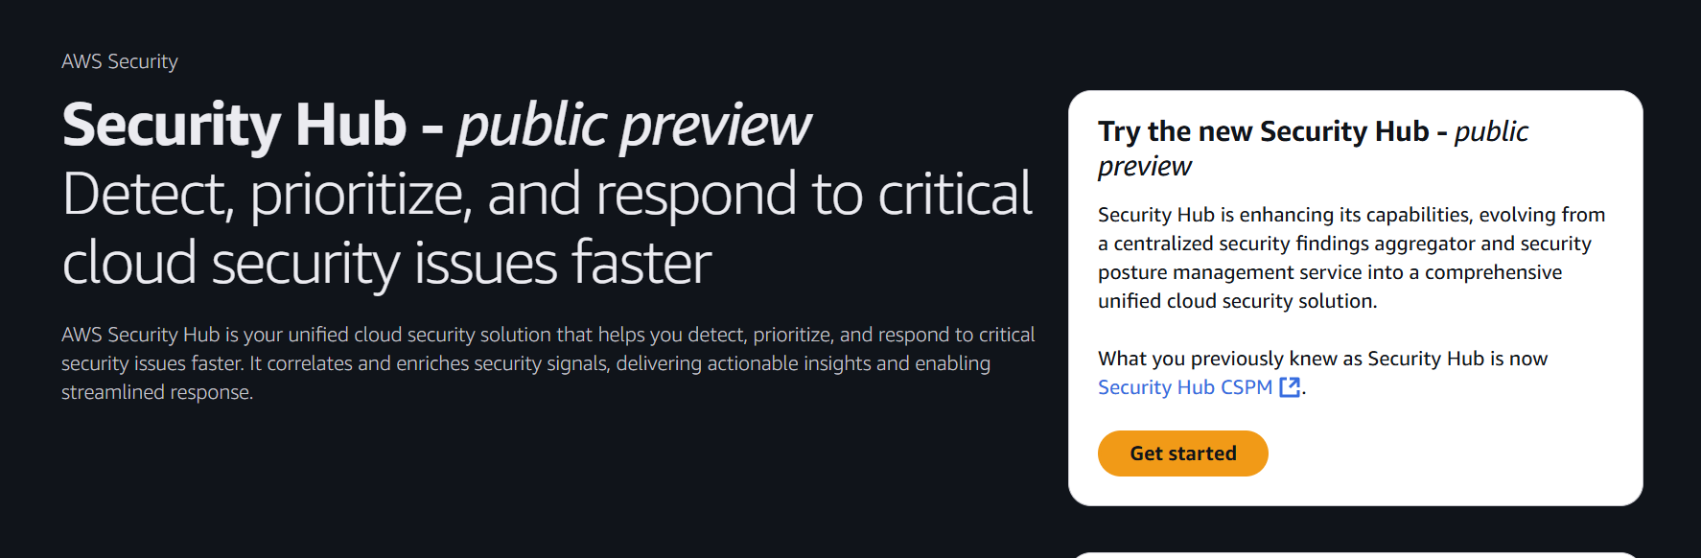
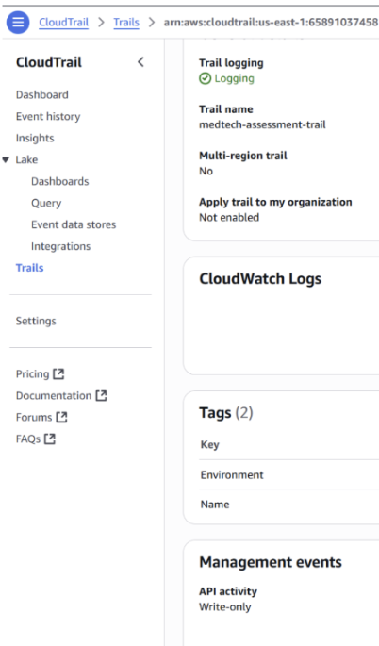
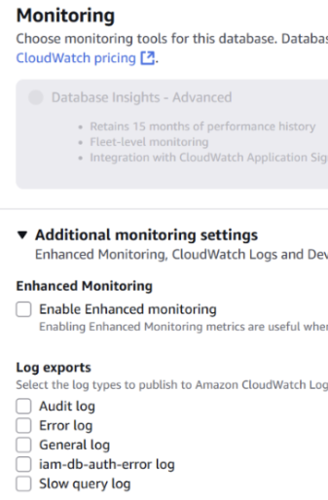
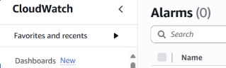
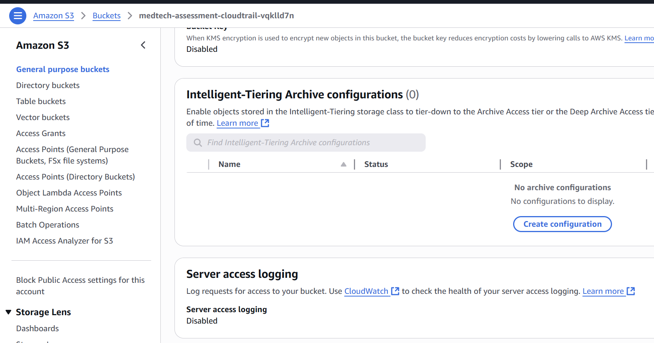
LOGGING AND MONITORING
Critical – Real time monitoring
There is no configuration in place for real time monitoring or alerting of security events. Services such as Amazon GuardDuty, AWS Security Hub and CloudWatch alarms are not provisioned.
High – Centralized Logging
Centralized collection and Generation of Logs - Disabled for key services like RDS, S3, EC2, load balancers and lambda functions.
Medium – CloudTrail
CloudTrail is configured to log only write events. Log file validation is also disabled.
Notes:
This slide summarizes our key findings and remediation plan for the Data Security and Privacy domain.
The Patient Records bucket presents the most critical issue: PHI data stored with only SSE-S3 encryption, no versioning, and no audit trail. This violates HIPAA encryption and integrity safeguards.
The CloudTrail audit bucket, rated high, lacks immutability controls. Without versioning or Object Lock, audit evidence could be deleted or altered.
Finally, the AI Training bucket, while not containing direct PHI, poses moderate risk due to unsecured datasets and potential model data leakage.
Our remediation strategy focuses on three phases: Immediate encryption and logging fixes, short-term lifecycle and immutability enhancements, and long-term automation through AWS Config and tagging.
Once these measures are in place, MedTech’s data protection posture will meet both HIPAA and CSA CCM standards for encryption, integrity, and audit control.

Slide 11
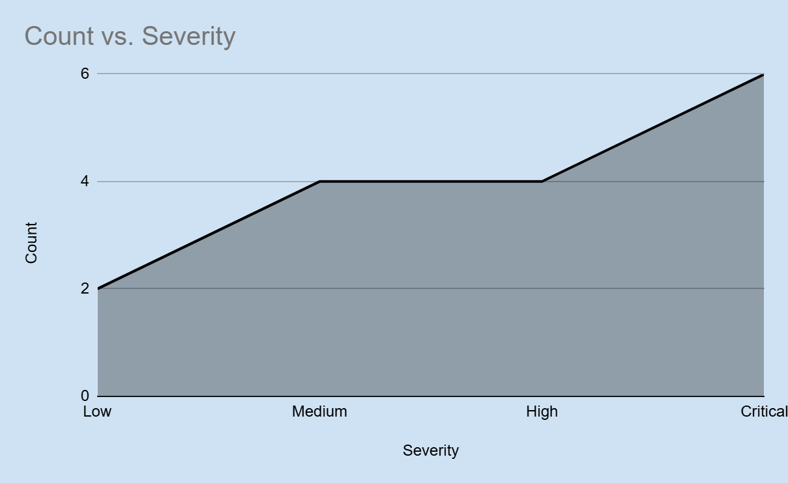
Risk & Priority Distribution
TOP PRIORITIES
IVS - DATABASE EXPOSED TO INTERNET
IVS - SSH ACCESS EXPOSED TO INTERNET
IAM - MFA ENFORCEMENT
IAM - ROOT ACCOUNT WITHOUT MFA
DSP - UNENCRYPTED AND NON AUDITABLE PHI STORAGE
LOG - NO REAL TIME MONITORING
Notes:
This slide summarizes the consolidated risk posture across MedTech’s AWS environment using a color-coded heatmap.
On the top right of the matrix, we can see the Critical risks — the unencrypted PHI in the DSP domain and the root account without MFA under IAM. These are both likely and severe, posing immediate compliance and security threats.
Moving into the High risk quadrant, we find gaps such as CloudTrail logs without immutability and publicly exposed network ports on the RDS instance. These are less likely to occur than credential compromise but would have serious consequences if exploited.
The Medium risks include issues like unsecured AI datasets, missing VPC flow logs, and lack of GuardDuty monitoring. These represent operational weaknesses that reduce visibility and forensic capability.
Finally, Low risks, such as unsecured public data buckets, have limited sensitivity or exposure.
The purpose of this visualization is to help leadership prioritize remediation—focusing first on Critical DSP and IAM issues, then addressing High and Medium risks in the next remediation phase.

Slide 12
Remediation Roadmap - Critical Actions
🔴 Immediate Actions (24-48 Hours)
# | Action | AWS Implementation | Owner
1 | Disable RDS public access | RDS Console → Modify → Publicly accessible: No | DevOps
2 | Restrict RDS security group | EC2 → SG → db-sg → Remove 0.0.0.0/0 | Security
3 | Enable root MFA | IAM → Root user → Enable MFA | CISO
4 | Delete unused access keys | IAM → Users → Security credentials | Security
5 | Enable S3 KMS encryption | S3 → patient-records → Default encryption: KMS | DevOps
⚠️ Critical: Execute items 1-3 immediately. Emergency change control required within 2 hours.
Notes:
“Our immediate remediation plan focuses on critical actions that must be completed within 48 hours to contain risk.
First, disable RDS public access and tighten its security group to block open inbound traffic.
Second, enable MFA for the root account and all IAM users to close the authentication gap.
Third, delete all unused access keys to reduce exposure to credential theft.
Finally, enable KMS encryption for S3 patient records to secure data at rest.
These actions are owned by DevOps and Security teams, with emergency change control required for the first three items.”

Slide 13
Remediation Roadmap - Critical Actions
🔴 Short-term fixes (1-2 Weeks)
Action | AWS Implementation | Priority
Enable GuardDuty | GuardDuty → Get Started → Enable | HIGH
Enable Security Hub | Security Hub → Enable → AWS Foundational | HIGH
Enable S3 versioning | S3 → Properties → Versioning + MFA Delete | HIGH
Enable S3 logging | S3 → Properties → Server access logging | HIGH
Password policy | IAM → Account settings → Password policy | MED
🟡 Long-Term Improvements (1-3 Months)
IAM Role Migration | Object Lock (WORM) | Network ACLs | SIEM Integration
Notes:
“In the next phase, we move from reactive fixes to proactive controls.
We’ll enable GuardDuty and Security Hub for continuous threat detection and compliance monitoring.
Implementing S3 versioning and server access logging strengthens audit readiness and forensic tracking — key HIPAA audit controls.
A new IAM password policy will enforce complexity and rotation.
Together, these actions harden MedTech’s environment against identity threats and establish the foundation for long-term improvements, including IAM role migration, immutable backups, and SIEM integration.”

Slide 14
Compliance Mapping
HIPAA Considerations
Execute and maintain AWS BAA, document shared-responsibility boundaries
Perform risk analysis and risk management; track remediation with owners and dates
Enforce least privilege and unique user IDs; require MFA for privileged access
AWS Well-Architected gaps
Security: missing MFA on root and weak IAM hygiene, limited detection, incomplete logging, inconsistent data protection
Reliability: incomplete backups/versioning, limited immutability, unclear DR objectives and testing cadence
Operational Excellence: undefined alert owners and runbooks, limited metrics and alarm thresholds, weak change tracking
Regulatory implications
Increased exposure to OCR enforcement for Security Rule deficiencies and inadequate logging
Contractual and liability risk without a current BAA and documented risk-management evidence
Incident investigations slowed by incomplete audit trails and lack of log integrity
Expected fines can cost upwards of $4 Million + reputational damages to Medtech
Notes:
This slide links our key findings directly to evidence gathered from the AWS Console and CLI, along with specific remediations required to close each gap.
For the Patient Records bucket, screenshots show that encryption relies only on default SSE-S3 with no KMS key, versioning is suspended, and logging is disabled. These settings leave PHI data mutable and non-auditable. The fix involves enabling KMS encryption, versioning, and Object Lock to meet HIPAA’s integrity and audit standards.
The CloudTrail Logs bucket displayed similar issues—no versioning, no immutability, and default SSE-S3 encryption. Since CloudTrail logs serve as forensic evidence, the remediation emphasizes KMS encryption, Object Lock, and strict write permissions for log services only.
Lastly, the AI Training bucket contained unclassified model and dataset files, with no encryption or logging. In addition to HIPAA, this introduces risks recognized in the OWASP LLM Top 10, such as prompt-injection and data-leakage vulnerabilities. The remediation adds KMS encryption, tagging, versioning, and network isolation.

Slide 15
TOP 4 RECOMMENDATIONS
Harden IAM
Encrypt Data
Network Segmentation
Monitoring and Logging
Enforce MFA and strong password policies
Set default KMS encryption for S3 & RDS
Disable public database access & apply ACLs
SIEM Integration, Enable GuardDuty & Security Hub

Slide 16
$2,400
~120 Hrs
Full Regulatory Compliance
Stronger Operational Security
Notes:
This roadmap outlines the remediation priorities by timeframe, along with resource estimates in both engineering hours and projected AWS costs.
Immediate actions—enabling KMS encryption, versioning, and MFA—can be completed in under two days and cost less than $200 in additional AWS service fees.
The short-term phase introduces monitoring, auditing, and access refinement through GuardDuty, Security Hub, and IAM policy restructuring. This will take roughly one to two weeks and cost approximately $500–$700 depending on log volume.
Finally, the long-term phase focuses on sustainability and automation, integrating AWS Config rules, Service Control Policies, and compliance audits. This phase requires the most effort but ensures continuous alignment with HIPAA and CSA CCM.
Overall, the investment—about $2,400 and 120 total engineer hours—brings MedTech into full regulatory compliance with strong operational security.

Slide 17
Thank you!
Notes:
In conclusion, this assessment demonstrated the importance of aligning technical implementation with established security frameworks like the CSA Cloud Controls Matrix, HIPAA, and the AWS Well-Architected Framework.
The remediation steps we proposed will not only ensure compliance but also position MedTech for scalability, resilience, and continuous monitoring in the future.
On behalf of our team, we’d like to thank our instructor, George Werbacher, and Carnegie Mellon University for their guidance throughout this project.
Thank you for your time and attention. We welcome any questions.

